Slide 1
CS109 Review
CS 109
Lecture 27
May 26th, 2016

Slide 2
What did we do

Slide 3
Learning Goals

Slide 4
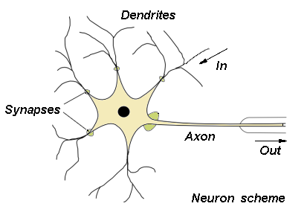
Biological Basis for Neural Networks
A neuron Logistic Regression
Your brain Neural Network
Actually, it’s probably someone else’s brain
x₀
𝜃₁
x₂
𝜃₂
x₃
𝜃₃
x₄
𝜃₄
x₁
x₂
x₃
x₄

Slide 5
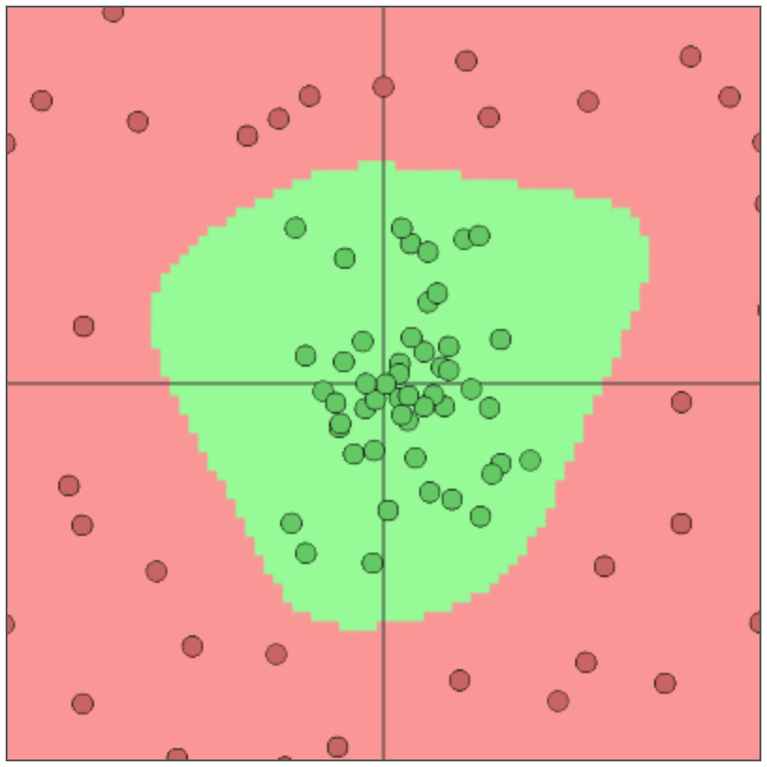
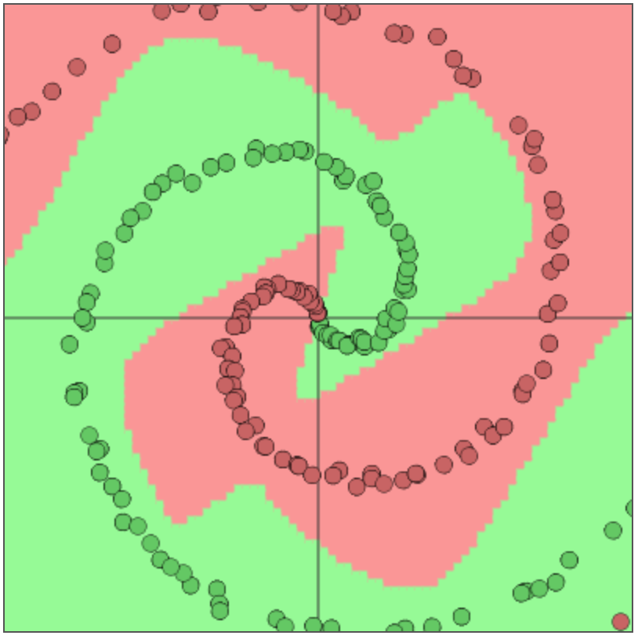
Neural Networks are Turing Complete
Some datasets are not linearly separable
These are classifiers learned by neural networks
http://cs.stanford.edu/people/karpathy/convnetjs/demo/classify2d.html

Slide 6





Best Neuron Stimuli
Neuron 10
Neuron 11
Neuron 12
Neuron 13
Le, et al., Building high-level features using large-scale unsupervised learning. ICML 2012
Input to another layer above
(image with 8 channels)
Number of output
channels = 8
LCN Size = 5
H
Pooling Size = 5
Number
of maps = 8
One layer
W
RF size = 18
Number of input
channels = 3
Image Size = 200

Slide 7
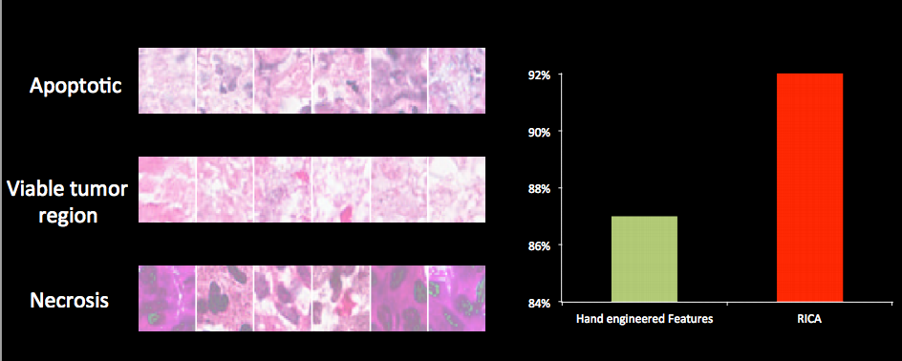
Vision has Social Implications
Neural network

Slide 8
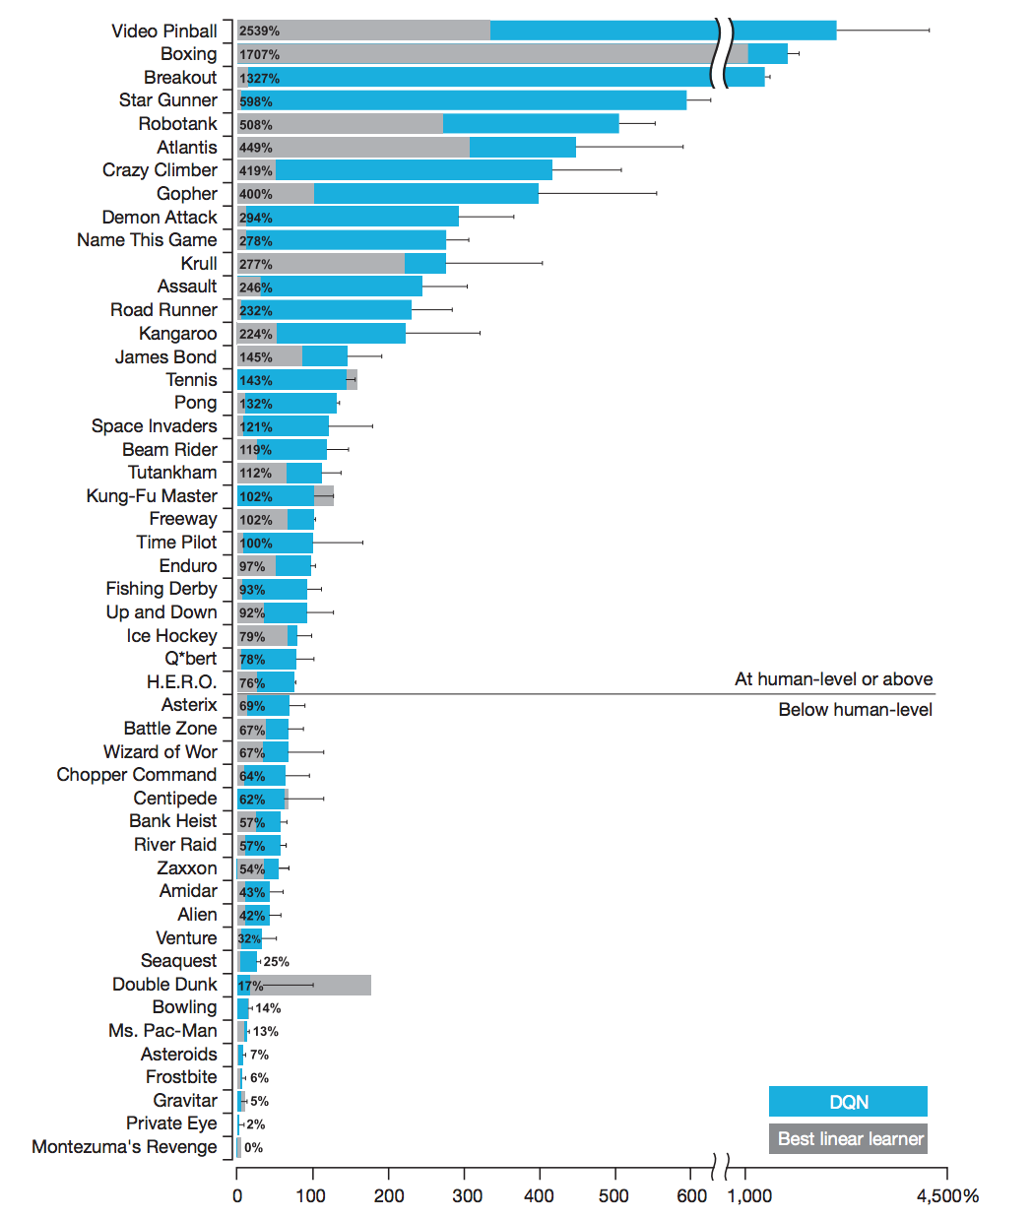
Deep Mind Atari Games
Score compared to best human

Slide 9

Alpha GO

Slide 10
Only type of AI worth knowing?

Slide 11
No!

Slide 12
Predictions vs Understanding
In machine learning, maintain critical perspective
Making predictions is only part of the story
Humans solve many different tasks. Don’t just predict.
Example
True statement: palm size negatively correlates with life expectancy
The larger your palm size, the shorter your life (on average)
Why?
Women have smaller palms than men on average
Women live 5 years longer than men on average
Sometimes you need better model of your domain!

Slide 13
Bayesian Networks
Graphical representation of joint probability distribution
Node: random variable
Arc (X, Y): variable X has direct influence on variable Y
Call X a “parent” of Y
Each node X has conditional probability: P(X | parents(X))
Graph has no cycles (loops by following arcs)
Called “Directed Acyclic Graph” (DAG)
Gender
Palm size
Life Expectancy

Slide 14
Shows Conditional Independence
Gender
Conditional independence encoded in network
Each node (variable) is conditionally independent of its non-descendants, given its parents
In network above, Palm Size (PS) and Life Expectancy (LE) are conditionally independent, given Gender (G)
Formally: P(PS, LE | G) = P(PS | G) P(LE | G)
Network structure provides insight about domain
Palm size
Life Expectancy

Slide 15
Conditional Probability Tables
Gender
Each node has conditional probability table (CPT)
For node X: P(X | Parents(X))
Conditional independence modularizes joint probability:
Palm size
P(G = M) = 0.49
P(G = F) = 0.51
Life Expectancy
P(PS = L | G = M) = 0.45
P(PS = M | G = M) = 0.35
P(PS = S | G = M) = 0.20
P(PS = L | G = F) = 0.10
P(PS = M | G = F) = 0.30
P(PS = S | G = F) = 0.60
P(LE = < 70 | G = M) = 0.20
P(LE = 70-80 | G = M) = 0.50
P(LE = > 80 | G = M) = 0.30
P(LE = < 70 | G = F) = 0.10
P(LE = 70-80 | G = F) = 0.35
P(LE = > 80 | G = F) = 0.55

Slide 16
Full Joint, Fewer Parameters
Gender
Each node has conditional probability table (CPT)
Reduces number of parameters needed in model
Normally, need 2 x 3 x 3 – 1 = 18 – 1 = 17 parameters
Here, need (2 – 1) + (6 – 2) + (6 – 2) = 9 parameters
Palm size
P(G = M) = 0.49
P(G = F) = 0.51
Life Expectancy
P(PS = L | G = M) = 0.45
P(PS = M | G = M) = 0.35
P(PS = S | G = M) = 0.20
P(PS = L | G = F) = 0.10
P(PS = M | G = F) = 0.30
P(PS = S | G = F) = 0.60
P(LE = < 70 | G = M) = 0.20
P(LE = 70-80 | G = M) = 0.50
P(LE = > 80 | G = M) = 0.30
P(LE = < 70 | G = F) = 0.10
P(LE = 70-80 | G = F) = 0.35
P(LE = > 80 | G = F) = 0.55

Slide 17
Naïve Bayes is a Bayesian Network
Welcome back, Naïve Bayes…
Now with new and improved “Bayesian Network” flavor!
Network structure encodes assumption:
Full joint distribution can be computed as:
Y
X₁
X₂
X_{m}

Slide 18
Answer Many Questions
Consider the following Bayes Net:
Determine P(A = T | B = T, R = T)
Enough Sleep (E)
Rocked assignments (R)
P(B = T | E = T) = 0.1
P(B = T | E = F) = 0.6
P(E = T) = 0.7
P(R = T) = 0.5
Bloodshot Eyes (B)
Got A on CS109 final (A)
P(A = T | E = T, R = T) = 0.8
P(A = T | E = F, R = T) = 0.7
P(A = T | E = T, R = F) = 0.4
P(A = T | E = F, R = F) = 0.2

